Slide 1




NEXT GEN EMPLOYABILITY PROGRAM
Creating a future-ready workforce
Team Members
College Name
Student Name : A.Malavika
Student ID : au960221104070
Arunachala College of Engineering for Women

Slide 2

CAPSTONE PROJECT SHOWCASE
Project Title
Car Rentals Application with Django Framework
Abstract | Problem Statement | Project Overview | Proposed Solution | Technology Used | Modelling & Results | Conclusion

Slide 3
Abstract
Car rental management system is a project which aims in developing a computerized system to maintain all the daily work of Car Rental .This project has many features which are generally Not available at regular car rental stores , like facility of customer login and a facility of admin login .It also has a facility of admin login through which the admin can monitor the whole system .It also has facility of an online notice board where Admin can put up information about the cars available in the exhibition and their prices and updating all data that go through the rental process. It has also a facility where user after logging in their accounts can see list of cars and its price and Availability of the car and also the customer can request the admin to add new type of cars by filling the cars request form. The admin after logging into his account is admin account can generate various reports such as cars report, users/ customer report. Overall, this project of ours is designed to help anyone make it easier during the process of buying or renting a car in the best possible way, as well as reducing human efforts and obtaining the best offers .
Source :

Slide 4
Problem Statement
The problem with some of the current system is that: Based on observations, some small companies already have a car rental system which is not a web based application. This is a limitation that gives them capability to store customer’s details, but at the same time they cannot make their services more available to the public through the internet, they rather make use of posters to advertise their services to the public. These types of companies can overcome these problems by switching to the web base application of their type of system. They also make use of phone call reservations which is also limited to many features as compare to a web base system. For example a customer may make a phone call reservation for a particular car, but when he/she comes to pick the car, he/she might turn not to like the car; this could be because the customer could not see a sample picture of the car she wants to rent.
Source :

Slide 5
Project Overview
The project overview for the car rentals application with Django framework involves creating a comprehensive online platform for users to easily rent cars. The application will include features like user registration, car listings, booking functionality, secure payment processing, and user reviews. By utilizing the Django framework, we aim to build a reliable and efficient system that enhances the car rental experience for both customers and car owners. The project will focus on providing a user-friendly interface, seamless booking process, and robust backend functionality to ensure a smooth and secure car rental process for all users involved.
Source :

Slide 6
Proposed Solution
The proposed solution for the car rentals application with Django framework would involve designing a user-friendly interface where customers can easily browse through a variety of cars, select their preferred vehicle, and make secure online bookings. The application would incorporate features like user registration and login, a comprehensive car catalog with detailed information, a booking system with calendar availability, secure payment processing through integration with payment gateways, and a review system for users to share feedback. By leveraging the Django framework for backend development, we can ensure a robust and scalable solution that meets the needs of both car renters and car owners, providing a seamless and efficient car rental experience.
Source :

Slide 7
User-friendly interface for easy navigation and car selection
Secure user registration and login system to protect user data.
Comprehensive car catalog with detailed information on make, model, availability, and pricing.
Booking system with calendar availability to facilitate easy reservations.
Source :

Slide 8
Integration with payment gateways for secure online transactions
Review system for users to share feedback and enhance trust among users
Leveraging Django framework for robust backend development, ensuring scalability and reliability.
Focus on providing a seamless and efficient car rental experience for both customers and car owners.
Source :

Slide 9

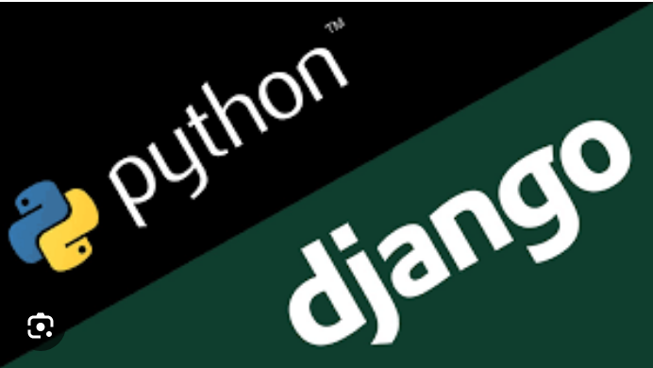
Technology Used
Front-end
Back-end
Source :

Slide 10
Modelling & Results
The car rentals application with Django framework, we would focus on creating database models for users, cars, bookings, and reviews. These models would establish relationships between different entities, such as users booking cars and leaving reviews. The results would include a functional web application where users can register, browse cars, make bookings, process payments securely, and leave reviews. By implementing these models effectively, we can ensure a well-structured and efficient system that delivers a seamless car rental experience for all users involved.
Source :

Slide 11
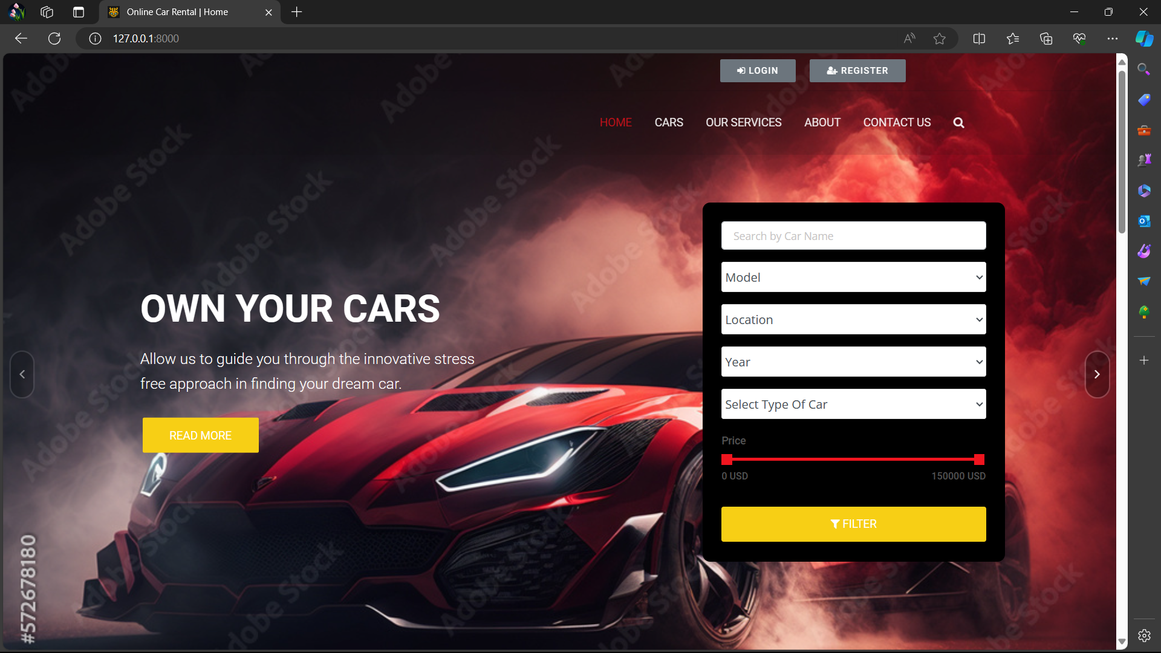
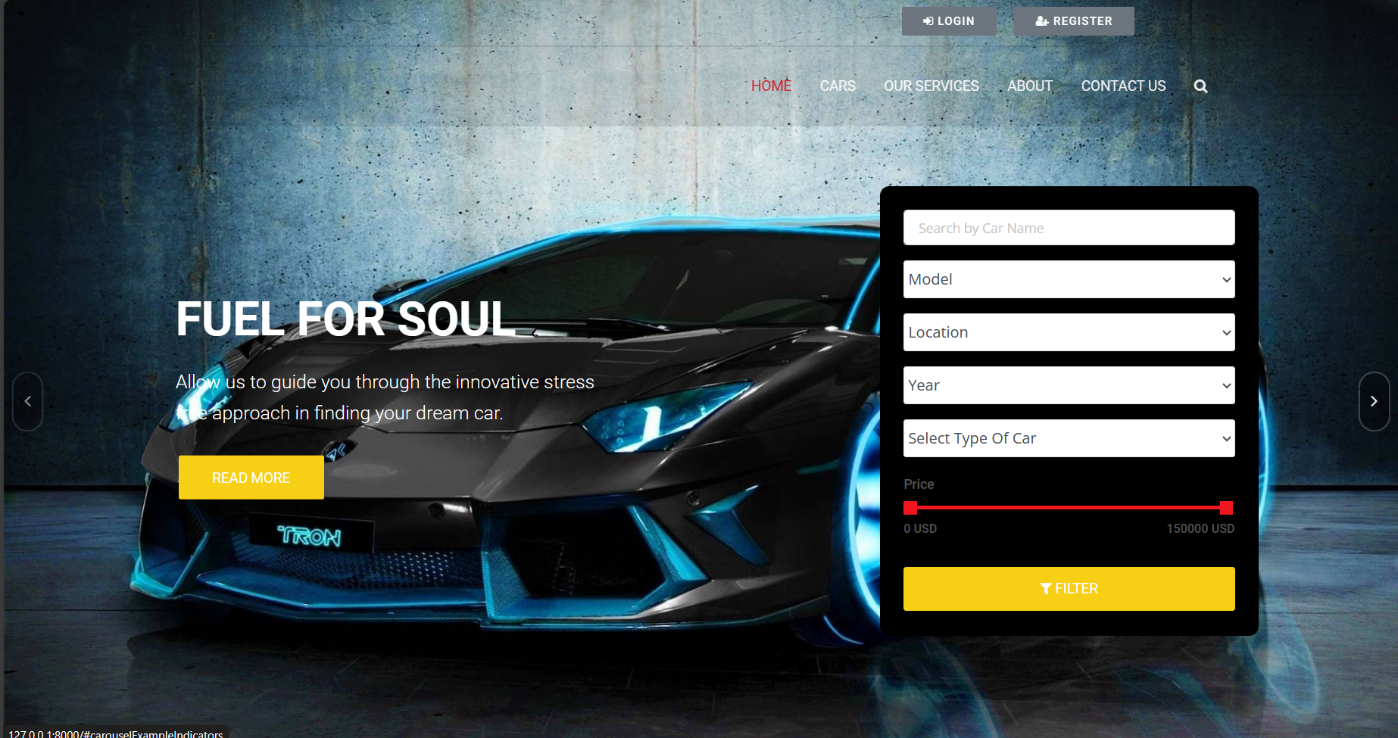
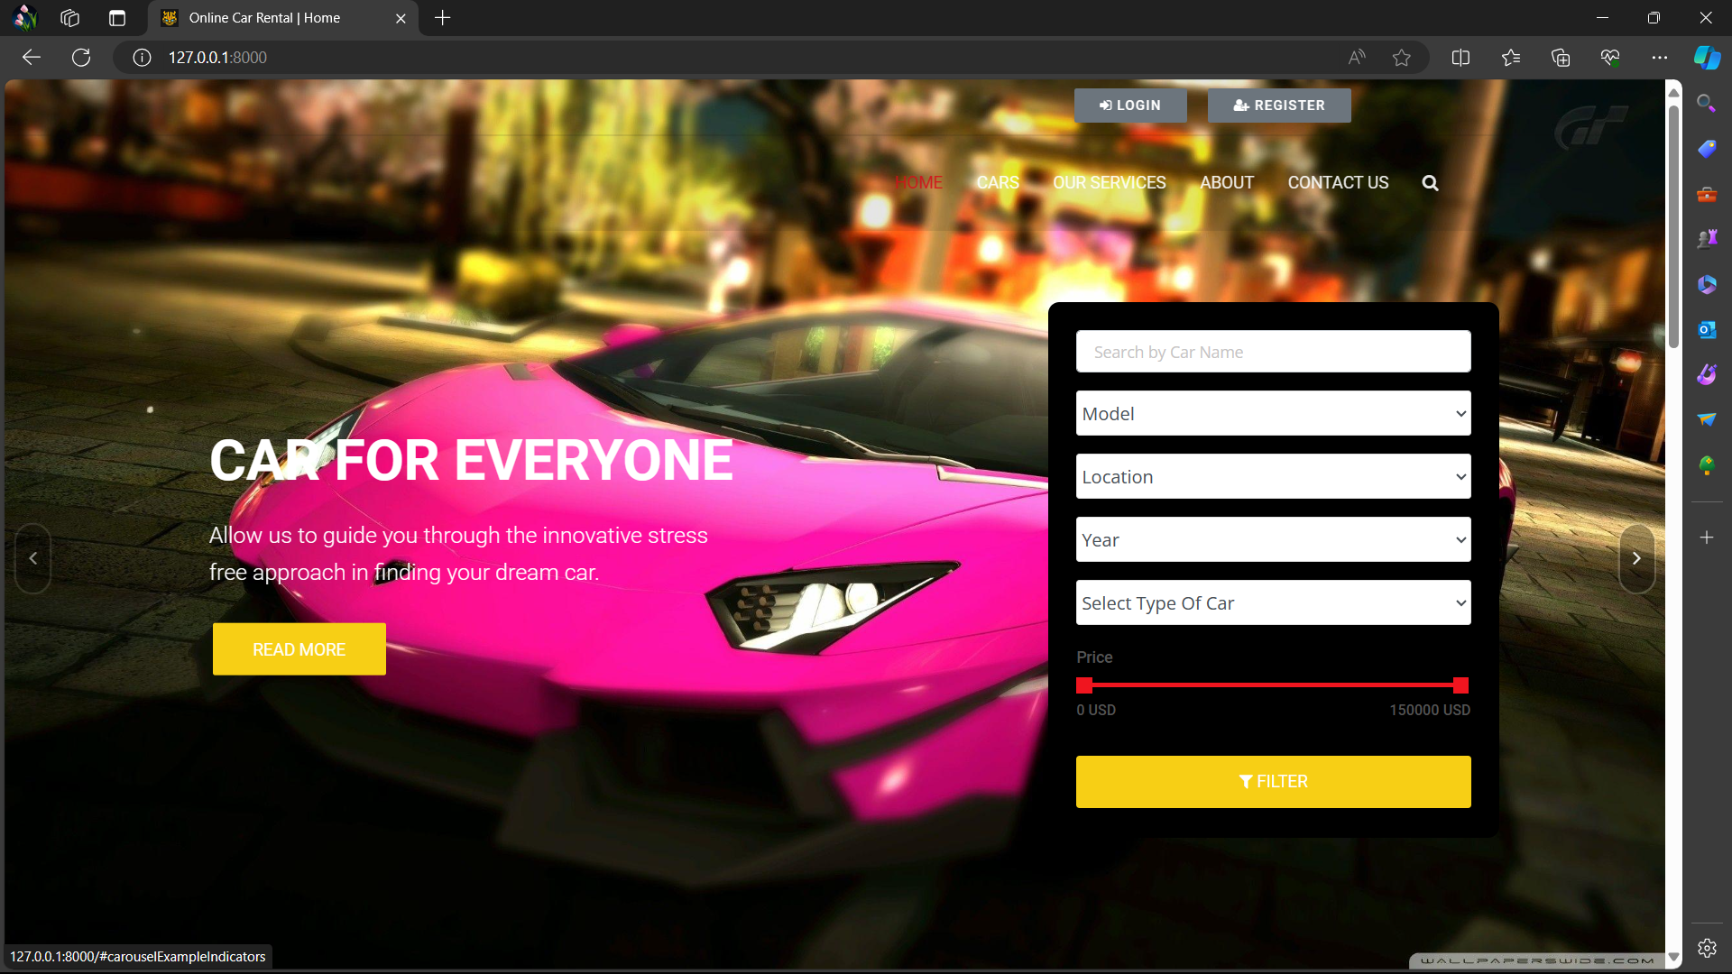
Homepage

Slide 12
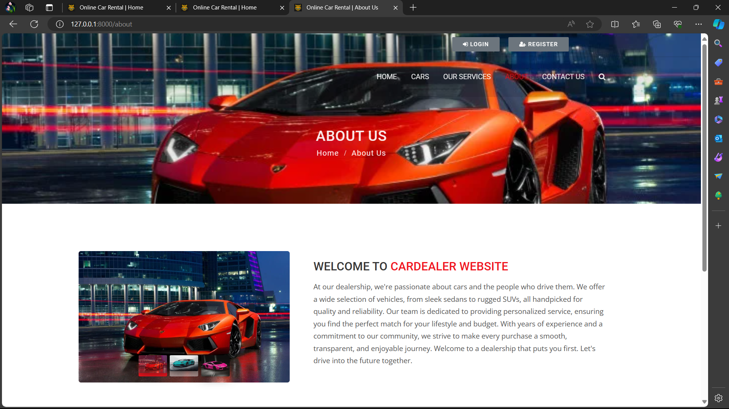
About-Us-Page

Slide 13
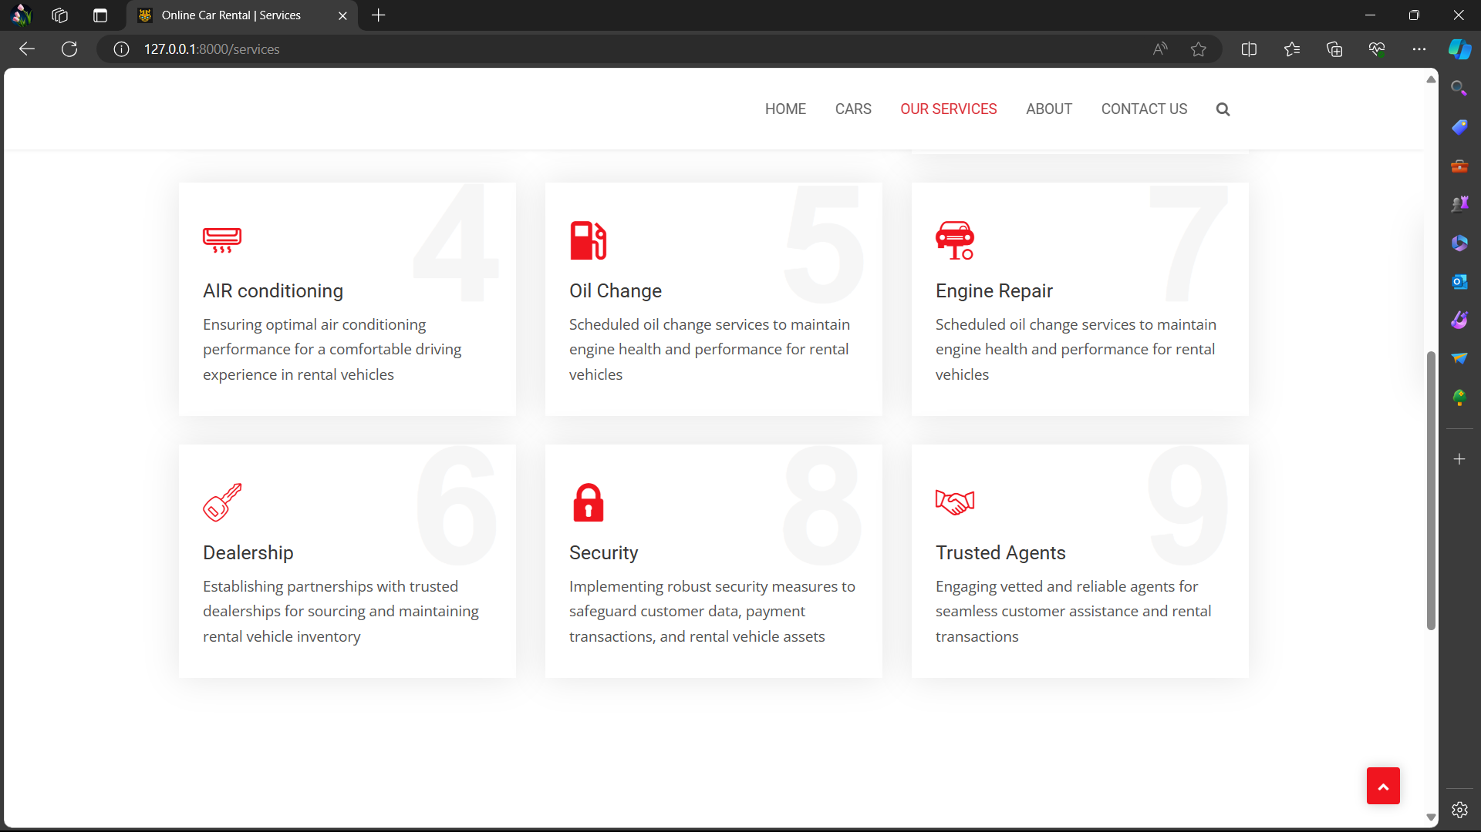
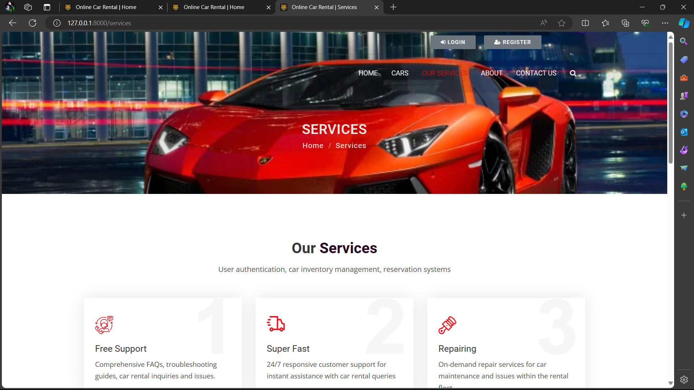
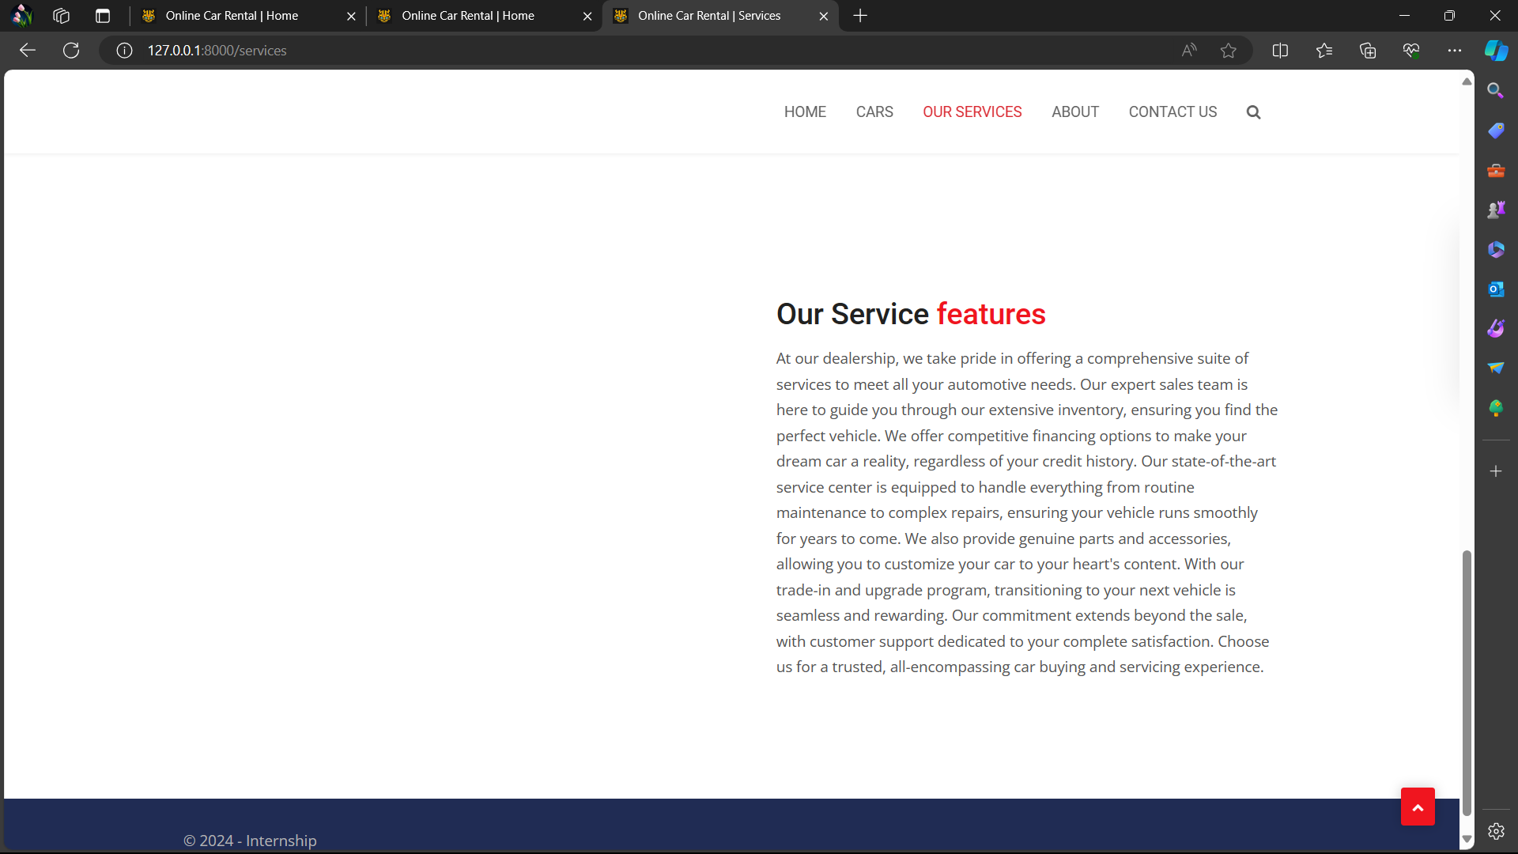
Service-Page

Slide 14
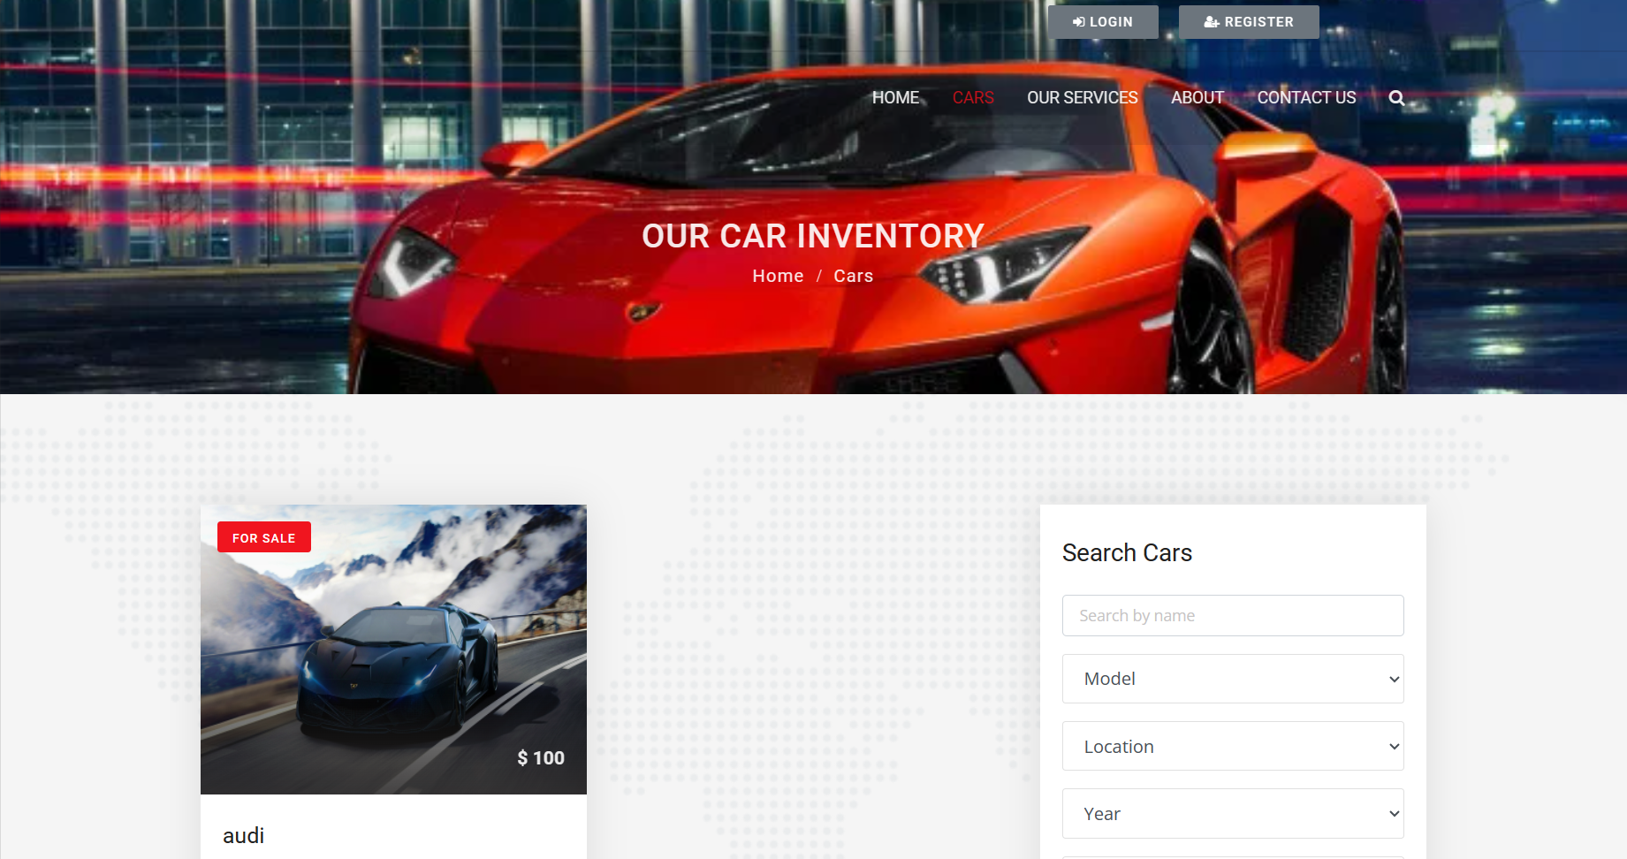
Cars-Page

Slide 15
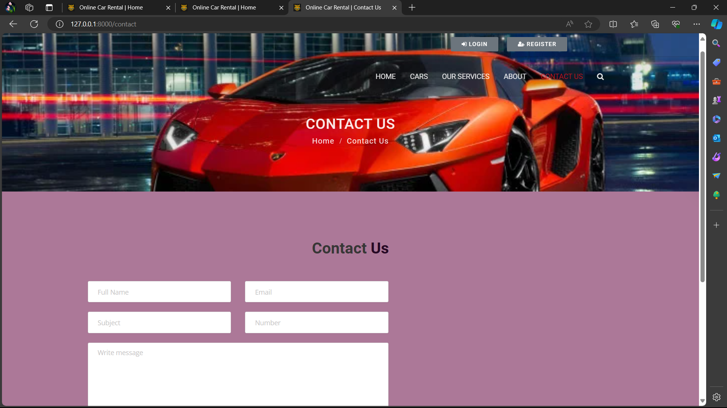
Contact Us-Page

Slide 16
Future Enhancements:
Add new car is representing the car list.
The user payment can be done as cash on delivery and online payment.
Add the current project for booking easy.
System uses for user become friendlier.
Detail of car more unified.
User easily gets their login password if user forgot their password.

Slide 17
Conclusion
In conclusion, developing a car rental application using the Django framework offers numerous benefits including robust security features, scalability, and rapid development capabilities. By leveraging Django's built-in functionalities such as authentication, admin interface, and ORM, we can create a reliable and efficient platform for users to browse, search, and book rental cars seamlessly. Additionally, Django's extensive ecosystem of third-party packages allows for easy integration of features like payment gateways, geolocation services, and email notifications, enhancing the overall user experience. With proper planning, design, and implementation, a Django-based car rental application has the potential to meet the needs of both rental companies and customers effectively, while providing a solid foundation for future growth and expansion.
Source :

Slide 18
Thank You!
Notes:
Thank You !!

